Slide 1
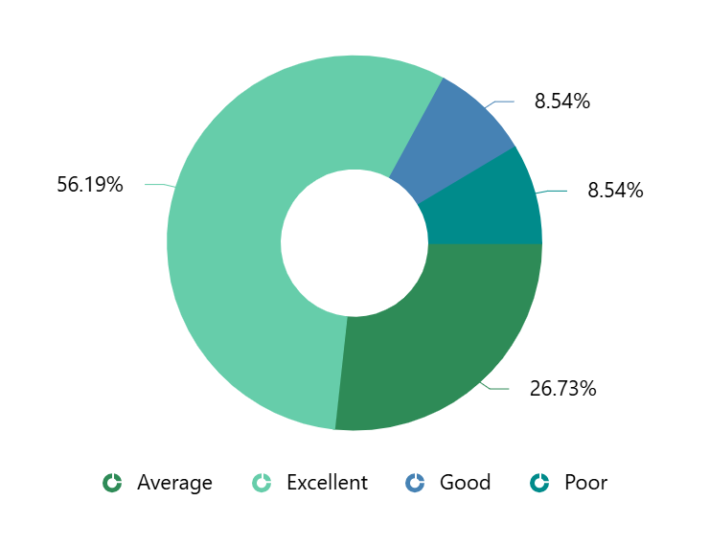
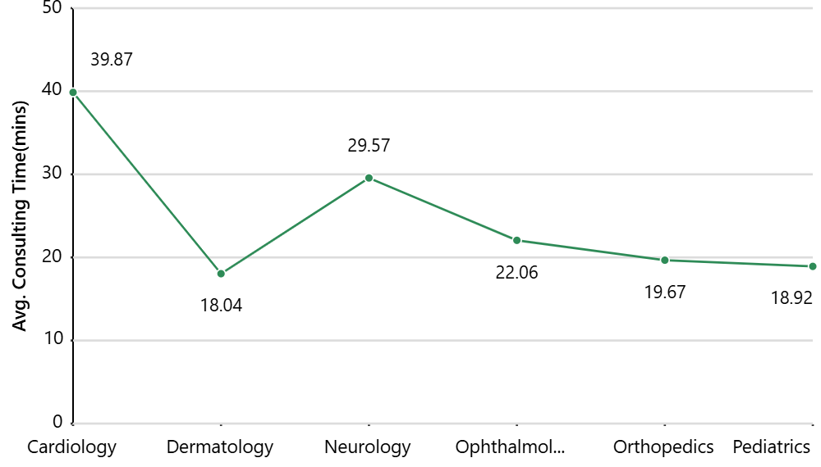
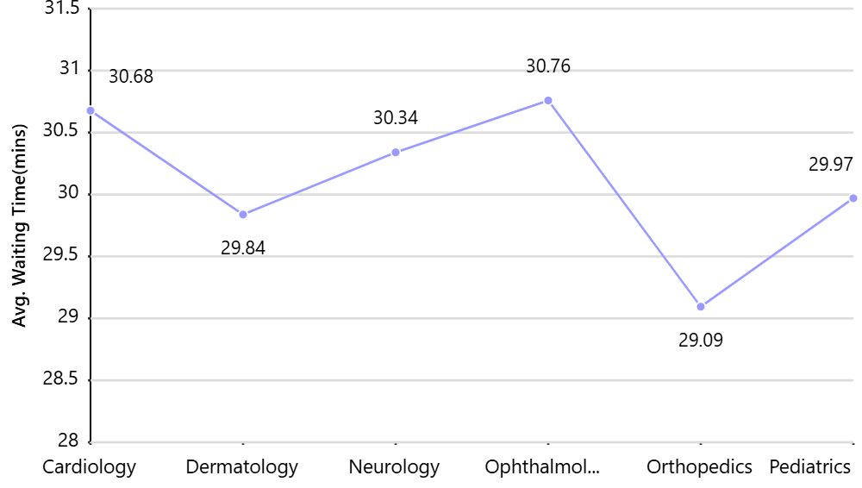
Patient Experience Analysis (Random data)
Patient Satisfaction by Department
Average Stay Duration by Department
Patients Count by Department
Average Waiting Time by Department
Department | Patients Count
Cardiology | 2344
Dermatology | 2321
Neurology | 2265
Ophthalmology | 2303
Orthopedics | 2295
Pediatrics | 2342

